Slide 1
AN AGILE VIEW OF PROCESS
ISE 2019

Slide 2
Rapid software development
Rapid development and delivery is now often the most important requirement for software systems
Businesses operate in a fast –changing requirement and it is practically impossible to produce a set of stable software requirements
Software has to evolve quickly to reflect changing business needs.
Rapid software development
Specification, design and implementation are inter-leaved
System is developed as a series of versions with stakeholders involved in version evaluation
User interfaces are often developed using an IDE and graphical toolset.

Slide 3
Agile methods
Dissatisfaction with the overheads involved in software design methods of the 1980s and 1990s led to the creation of agile methods. These methods:
Focus on the code rather than the design
Are based on an iterative approach to software development
Are intended to deliver working software quickly and evolve this quickly to meet changing requirements.
The aim of agile methods is to reduce overheads in the software process (e.g. by limiting documentation) and to be able to respond quickly to changing requirements without excessive rework.

Slide 4

AGILE
AGILE IS A SET OF VALUES AND PRINCIPLES
Agile is really a collection of beliefs that teams can use for making decision about how to do the work of developing software.

Slide 5
Effective (rapid and adaptive) response to change
Effective communication among all stakeholders
Drawing the customer onto the team
Organizing a team so that it is in control of the work performed
Yielding …
Rapid, incremental delivery of software

Slide 6
AGILE DEVELOPMENT PROCESS
In software development term agile is means the ability to respond to changes , changes from Requirements ,Technology and People.
Its an iterative and incremental process.
Direct collaboration with the customers.
Delivers multiple software increments.
Engineering actions are carried out by cross out by cross functional teams.
Effective (rapid and adaptive) response to change
Effective communication among all stakeholders
Drawing the customer onto the team
Organizing a team so that it is in control of the work performed

Slide 7
Agile manifesto
Agile manifesto is only 68 words and very simply says that we can develop software better by valuing the items on the left side of the list more than the items on the right side.

Slide 8
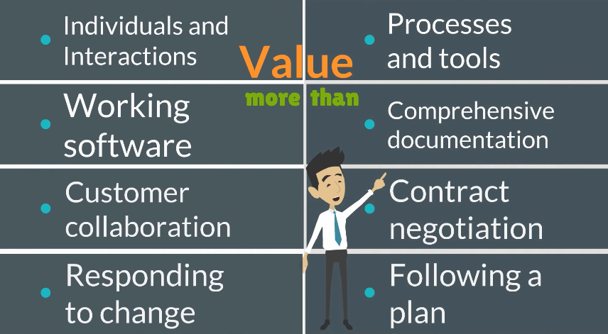

Slide 9
In addition to the values of the manifesto, there are 12 principles that support the values.
Once again the principles are very general and are less about telling you what to do than they’re about giving you the ability to make a good decision in a particular situation.

Slide 10
Agility Principles
1. Our highest priority is to satisfy the customer through early and continuous delivery of valuable software.
2. Welcome changing requirements, even late in development. Agile processes harness change for the customer's competitive advantage.
3. Deliver working software frequently, from a couple of weeks to a couple of months, with a preference to the shorter timescale.
4. Business people and developers must work together daily throughout the project.
5. Build projects around motivated individuals. Give them the environment and support they need, and trust them to get the job done.
6. The most efficient and effective method of conveying information to and within a development team is face–to–face conversation.

Slide 11
Agility Principles
7. Working software is the primary measure of progress.
8. Agile processes promote sustainable development. The sponsors, developers, and users should be able to maintain a constant pace indefinitely.
9. Continuous attention to technical excellence and good design enhances agility.
10. Simplicity – the art of maximizing the amount of work not done – is essential.
11. The best architectures, requirements, and designs emerge from self–organizing teams.
12. At regular intervals, the team reflects on how to become more effective, then tunes and adjusts its behavior accordingly.

Slide 12
Problems with agile methods
It can be difficult to keep the interest of customers who are involved in the process.
Team members may be unsuited to the intense involvement that characterizes agile methods.
Prioritising changes can be difficult where there are multiple stakeholders.
Maintaining simplicity requires extra work.
Contracts may be a problem as with other approaches to iterative development.

Slide 13
Agile methods and software maintenance
Most organizations spend more on maintaining existing software than they do on new software development. So, if agile methods are to be successful, they have to support maintenance as well as original development.
Two key issues:
Are systems that are developed using an agile approach maintainable, given the emphasis in the development process of minimizing formal documentation?
Can agile methods be used effectively for evolving a system in response to customer change requests?
Problems may arise if original development team cannot be maintained.

Slide 14
Plan-driven and agile development
Plan-driven development
A plan-driven approach to software engineering is based around separate development stages with the outputs to be produced at each of these stages planned in advance.
Not necessarily waterfall model – plan-driven, incremental development is possible
Iteration occurs within activities.
Agile development
Specification, design, implementation and testing are inter-leaved and the outputs from the development process are decided through a process of negotiation during the software development process.

Slide 15
Plan-driven and agile development

Slide 16
Technical, human, organizational issues
What type of system is being developed?
Plan-driven approaches may be required for systems that require a lot of analysis before implementation (e.g. real-time system with complex timing requirements).
What is the expected system lifetime?
Long-lifetime systems may require more design documentation to communicate the original intentions of the system developers to the support team.
What technologies are available to support system development?
Agile methods rely on good tools to keep track of an evolving design
How is the development team organized?
If the development team is distributed or if part of the development is being outsourced, then you may need to develop design documents to communicate across the development teams.

Slide 17
Technical, human, organizational issues
Are there cultural or organizational issues that may affect the system development?
Traditional engineering organizations have a culture of plan-based development, as this is the norm in engineering.
How good are the designers and programmers in the development team?
It is sometimes argued that agile methods require higher skill levels than plan-based approaches in which programmers simply translate a detailed design into code

Slide 18
1. Extreme Programming (XP)
Extreme Programming (XP) is an agile software development framework that aims to produce higher quality software, and higher quality of life for the development team.
XP is a lightweight , efficient, low-risk, flexible, predictable, scientific, & fun way to develop software
Small to medium sized teams that work under vague (uncertain) rapidly changing requirements.

Slide 19
Extreme Programming (XP)
The most widely used agile process, originally proposed by Kent Beck
XP Planning
Begins with the creation of “user stories”
Agile team assesses each story and assigns a cost
Stories are grouped to for a deliverable increment
A commitment is made on delivery date
After the first increment “project velocity” is used to help define subsequent delivery dates for other increments

Slide 20
VALUES OF XP
Values
The five values of XP are communication, simplicity, feedback, courage, and respect and are described in more detail below.
Communication
Software development is inherently a team sport that relies on communication to transfer knowledge from one team member to everyone else on the team. XP stresses the importance of the appropriate kind of communication - face to face discussion with the aid of a white board or other drawing mechanism.

Slide 21
Simplicity
Simplicity means “what is the simplest thing that will work?” The purpose of this is to avoid waste and do only absolutely necessary things such as keep the design of the system as simple as possible so that it is easier to maintain, support, and revise. Simplicity also means address only the requirements that you know about; don’t try to predict the future.
Feedback
Through constant feedback about their previous efforts, teams can identify areas for improvement and revise their practices. Feedback also supports simple design. Your team builds something, gathers feedback on your design and implementation, and then adjust your product going forward.
Courage
Kent Beck defined courage as “effective action in the face of fear.” This definition shows a preference for action based on other principles so that the results aren’t harmful to the team. You need courage to raise organizational issues that reduce your team’s effectiveness. You need courage to stop doing something that doesn’t work and try something else. You need courage to accept and act on feedback, even when it’s difficult to accept.

Slide 22
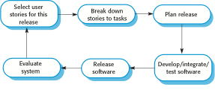
More focus on software development

Slide 23
Extreme programming practices
Principle or practice
Incremental planning
Requirements are recorded on story cards and the stories to be included in a release are determined by the time available and their relative priority. The developers break these stories into development ‘Tasks’.
Small releases
The minimal useful set of functionality that provides business value is developed first. Releases of the system are frequent and incrementally add functionality to the first release.
Simple design
Enough design is carried out to meet the current requirements and no more.
Test-first development
An automated unit test framework is used to write tests for a new piece of functionality before that functionality itself is implemented.
Refactoring
All developers are expected to refactor the code continuously as soon as possible code improvements are found. This keeps the code simple and maintainable.

Slide 24
Extreme programming practices
Pair programming
Developers work in pairs, checking each other’s work and providing the support to always do a good job.
Collective ownership
The pairs of developers work on all areas of the system, so that no islands of expertise develop and all the developers take responsibility for all of the code. Anyone can change anything.
Continuous integration
As soon as the work on a task is complete, it is integrated into the whole system. After any such integration, all the unit tests in the system must pass.
Sustainable pace
Large amounts of overtime are not considered acceptable as the net effect is often to reduce code quality and medium term productivity
On-site customer
A representative of the end-user of the system (the customer) should be available full time for the use of the XP team. In an extreme programming process, the customer is a member of the development team and is responsible for bringing system requirements to the team for implementation.

Slide 25
Extreme Programming (XP)

Slide 26
Spike solution:
Is a very simple program to explore potential solutions. Difficult designs should be modeled using prototype.
Refactoring :
Improves the internal structure of the code but external behavior not affected.

Slide 27
2. SCRUM
Scum is agile development process for building complex and sustainable products.
3 roles
Product Owner
Scrum Master
Scrum Team

Slide 28
PRODUCT OWNER
The product owner creates a product backlog( essentially a wishlist of tasks that need to be prioritized in project).
Decide Release date and content.
Prioritize features according to market value.
Accept or Reject work results.

Slide 29
Scrum Master
The scrum master conducts daily meetings.
Ensures that the team is fully functional and productive.
Shield the team from external interfaces.
Responsible for management of the project.

Slide 30
Scrum Team
Typically 5 to 10 people.
Teams are cross functional and self organizing.
Scrum team determines which items and in what order are to be executed.

Slide 31
Scrum
Originally proposed by Schwaber and Beedle
Scrum—distinguishing features
Development work is partitioned into “packets”
Testing and documentation are on-going as the product is constructed
Work occurs in “sprints” and is derived from a “backlog” of existing requirements
Meetings are very short and sometimes conducted without chairs
“demos” are delivered to the customer with the time-box allocated

Slide 32
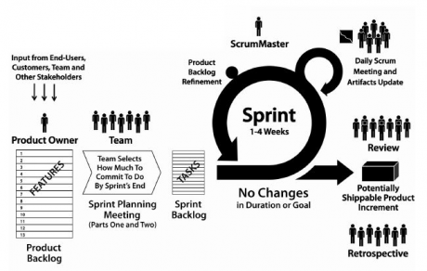

Slide 33
